Slide 1
Exploratory Data Analysis Project Report on Chocolate Bar Ratings
Group Members
Elliot Kojo Attipoe
Isaac Armah-Mensah
Franklin Kome Amoo

Slide 2

Introduction
Exploratory Data Analysis is part of the data science lifecycle

Slide 3
Definition of EDA
Exploratory Data Analysis (EDA) generally refers to the process of performing initial investigations on data with the aim of discovering patterns, anomalies, testing hypothesis or checking assumptions with the aid of descriptive statistics and graphical representations.

Slide 4
Steps involved in EDA
Step 1: Understanding the dataset
Step 2: Cleaning the dataset
Step 3:
Analysis of relationship

Slide 5
Source of dataset
The dataset used for this project is the Chocolate Bar Ratings which is compiled by Brady Brelinski, Founding Member of the Manhattan Chocolate Society.
Column | Description
Company (Maker-if known) | Name of the company manufacturing the bar.
Specific Bean Originor Bar Name | The specific geo-region of origin for the bar.
REF | A value linked to when the review was entered in the database. Higher = more recent.
ReviewDate | Date of publication of the review.
CocoaPercent | Cocoa percentage (darkness) of the chocolate bar being reviewed.
CompanyLocation | Manufacturer base country.
Rating | Expert rating for the bar.
BeanType | The variety (breed) of bean used, if provided.
Broad BeanOrigin | The broad geo-region of origin for the bean.

Slide 6
Hypothesis
Over time, there has been a correlation between cocoa ratings and the proportion of cocoa in a chocolate bar, as the quality of cocoa beans and chocolate bars has improved.

Slide 7
Hypothetical Questions.
Which countries produces the best cocoa beans?
Which countries have the highest-rated chocolate bars?
Is there relationship between the proportion of cocoa in chocolate bar and the rating?
What are the top ten companies with the highest rating?
What is the pattern over the years with respect to Cocoa percentage in bar?
Which Countries produces the best chocolate bars?
Which chocolate beans have the highest ratings?
Has the quality of cocoa change over the years?

Slide 8
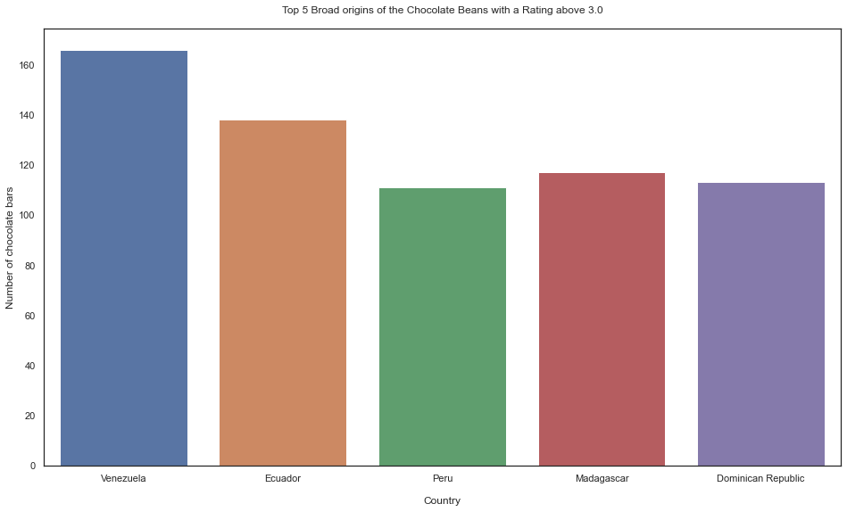
Which countries produces the best cocoa beans?

Slide 9
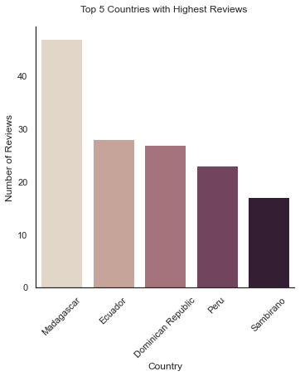
Which countries have the highest-rated chocolate bars?

Slide 10
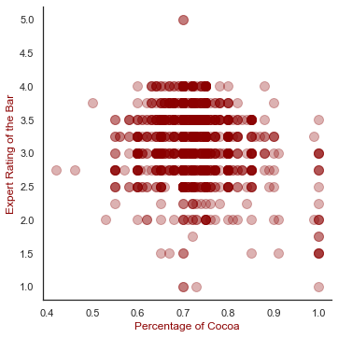
Is there relationship between the proportion of cocoa in chocolate bar and the rating?

Slide 11
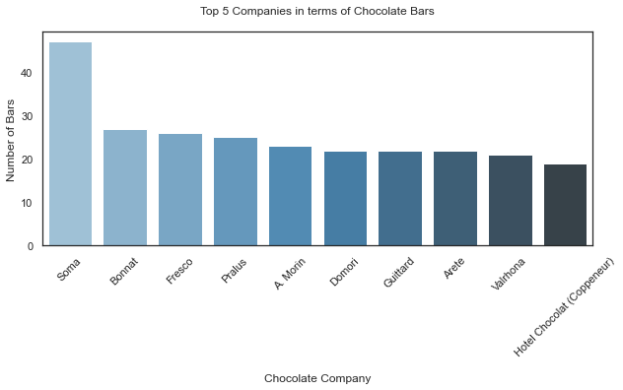
What are the top ten companies with the highest rating?

Slide 12
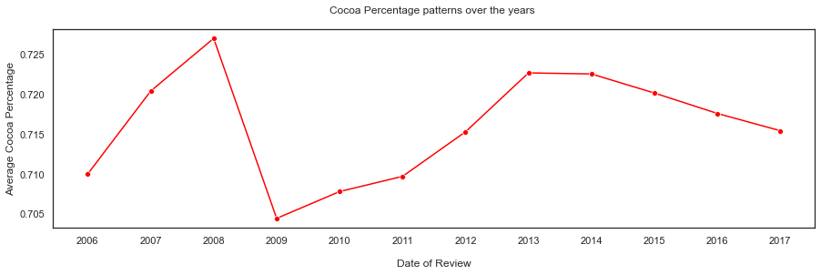
What is the pattern over the years with respect to rating?

Slide 13
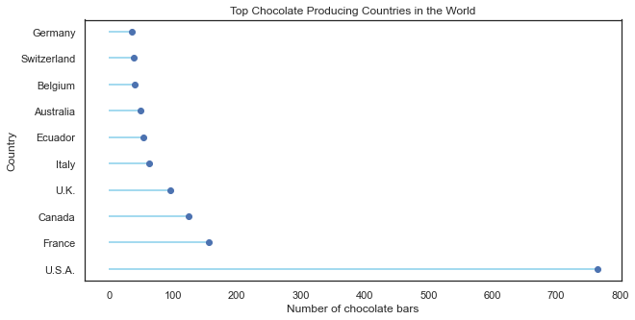
Which Countries produces the best chocolate bars?

Slide 14
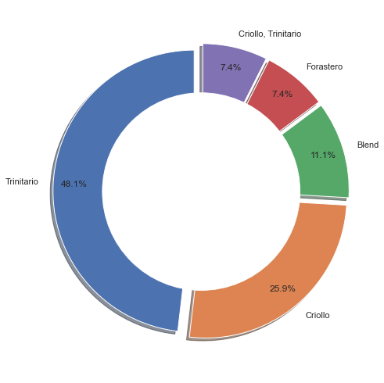
Which chocolate beans have the highest ratings?

Slide 15
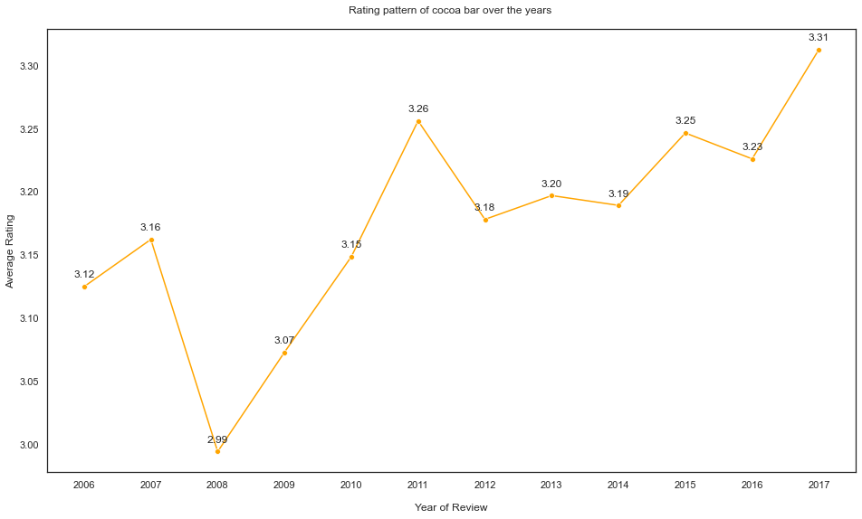
Has the quality of chocolate change over the years?

Slide 16
Conclusion
From the exploratory data analysis, our hypothesis turns out to be false.
It was our expectation that the percentage of cocoa used in producing a chocolate bar should determine the quality and taste of the chocolate hence the chocolate bar getting high ratings from reviewers.
But from the analysis, the rating does not have a correlation with the percentage of cocoa in chocolate bar.
The second part of our hypothesis which stated that the quality of chocolate bar should be improving over the year was also proven to be false.
From the analysis, the average rating of chocolate bars was fluctuating over the years which implied that the quality of the chocolate bar was not improving over the years as expected.

